Slide 1

Integrated Linux Storage Infrastructure
Partitioning, LVM, Backup, Automation and Monitoring on Ubuntu
Team Members
1.Pruthviraj M – Register No:[2411021061330]
2. Mariyani Vishal – Register No:[2411021061591]
3. Rohan Pujeri – Registere No:[2411021061648]
4. Ganesh Koti - Register No: [2411021061650]
Name of the Mentor
Prof.KUSUMA J
Linux Microproject | Unit III, IV | CO3, CO4 | Academic Year 2026-27

Slide 2
Agenda
1
Introduction and Problem Statement
8
Automation using cron
2
Objectives
9
Monitoring
3
Tools and System Requirements
10
Testing ,Results & Menu Validation
4
System Architecture
11
Challenges and Solutions
5
Implementation Steps & Menu Interface
12
Conclusion and Future Scope
6
Extend and Snapshot (LVM Management)
13
References
7
Backup and Restore

Slide 3
Introduction and Problem Statement
Storage is the foundation of every Linux server, but plain partitions have a fixed size and are hard to resize. LVM, backup, automation and monitoring, and a menu-driven Bash interface on Ubuntu.
Problem: How can Linux storage be managed so that it can grow, is backed up automatically, and warns us before it runs out of space?
Problem | Our Solution
Fixed disk space that cannot be extended easily | LVM: volumes extended online with lvextend
Risk of losing data | tar backup script with a tested restore
Manual work that gets forgotten | Automation with Bash scripts and cron
A full disk goes unnoticed | Monitoring script that logs a WARNING above 80%

Slide 4
Objectives of the Project
Create and manage disk partitions using parted
Implement an automated backup with a tested restore
1
5
Build flexible storage with LVM (PV, VG, LV)
Automate tasks using Bash scripts and cron
2
6
Create ext4 filesystems and mount them permanently with fstab
Monitor disk usage and log a warning above 80%
3
7
Extend a volume online and take a snapshot
Develop a menu-driven Bash interface with input validation and error handling
4
8

Slide 5
Tools and System Requirements
Tool | Purpose
Ubuntu 25.04 | Operating system
Oracle VirtualBox | Virtual machine, virtual 10 GB disk
parted | GPT table and partitions
LVM commands | Flexible storage (PV, VG, LV)
ext4 and fstab | Filesystem and permanent mounting
tar | Compressed backups
Bash scripting | Backup and monitoring scripts
cron | Scheduling the scripts
df, lsblk, pvs, vgs, lvs | Checking and monitoring storage
sed, nano & Storage_manager.sh | Editing scripts and config files, menu driven bash interface
Hardware
PC or laptop with virtualization enabled
4 GB RAM and 2 CPU cores for the VM
25 GB virtual system disk (sda)
10 GB virtual extra disk (sdb)
Software
Ubuntu 25.04 (Plucky Puffin), 64-bit
Oracle VirtualBox
lvm2, parted, xfsprogs, rsync, sysstat, smartmontools
Bash, cron, tar, sed, nano

Slide 6
System Architecture
STORAGE STACK
Disk
/dev/sdb 10 GB
Partitions
sdb1 4G, sdb2 4G, sdb3 2G
PV
Physical volumes on the 3 partitions
VG
vg_storage, about 10 GB
LV
lv_data 600M, lv_backup 200M
Filesystem
ext4 on each LV
Mount point
/mnt/data and /mnt/backup
PROTECTION AND SUPERVISION
Backup
backup.sh compresses /mnt/data into /mnt/backup/data_DATE.tar.gz and records the result in /var/log/backup.log
Automation
cron runs backup.sh every day at 2 AM and monitor.sh every 10 minutes
Monitoring
storage_manager.sh provides menu options to view storage status and monitoring logs.storage_monitor.sh provides menu options to view storage status and monitoring logs

Slide 7
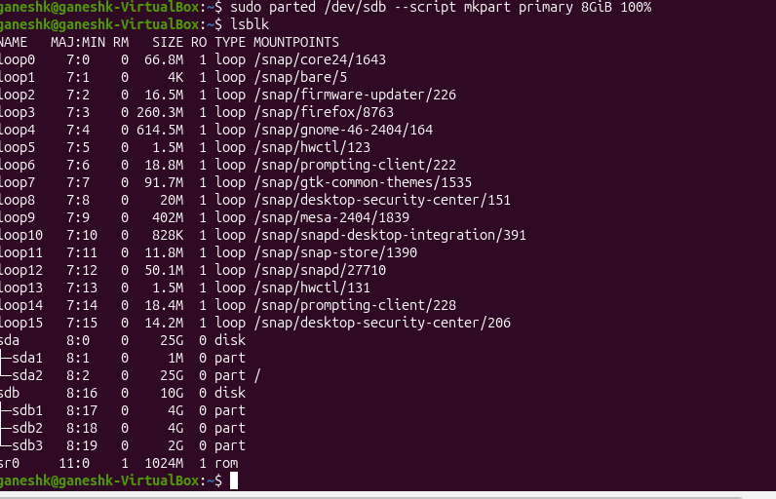
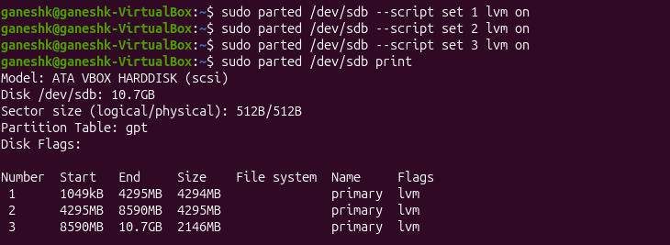
Implementation: Partitioning
A separate 10 GB disk(/dev/sdb) was used for storage, keeping it separate from the system disk
GPT partition table created with parted
Three partitions: sdb1 (4G), sdb2 (4G), sdb3 (2G)
All three flagged as lvm
sudo parted /dev/sdb --script mklabel gpt
sudo parted /dev/sdb --script mkpart primary 1MiB 4GiB
sudo parted /dev/sdb --script mkpart primary 4GiB 8GiB
sudo parted /dev/sdb --script mkpart primary 8GiB 100%
sudo parted /dev/sdb --script set 1 lvm on
lsblk: sdb with partitions sdb1, sdb2 and sdb3
parted print: lvm flag set on partitions 1, 2 and 3

Slide 8
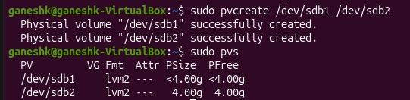
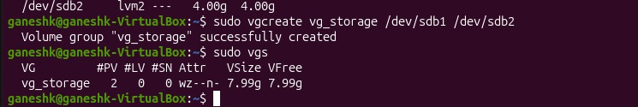
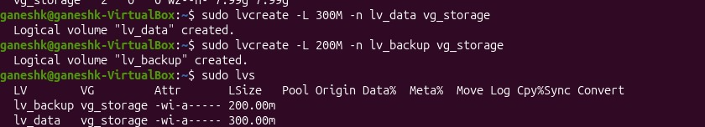
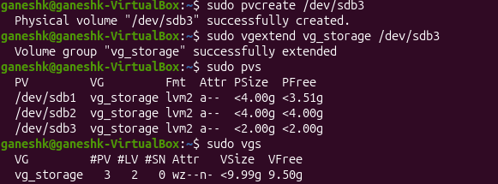
Implementation: LVM Setup
PV: pvcreate on sdb1 and sdb2
VG: vg_storage created from the PVs (about 8 GB)
LV: lv_data (600 MB) and lv_backup (200 MB)
sdb3 added later with vgextend, so the pool grew to about 10 GB
ADD SCREENSHOT HERE
phase3_pvs.png
Output of: sudo pvs
ADD SCREENSHOT HERE
phase3_vgs.png
Output of: sudo vgs
pvs: physical volumes
vgs: volume group vg_storage
sudo pvcreate /dev/sdb1 /dev/sdb2
sudo vgcreate vg_storage /dev/sdb1 /dev/sdb2
sudo lvcreate -L 300M -n lv_data vg_storage
sudo lvcreate -L 200M -n lv_backup vg_storage
ADD SCREENSHOT HERE
phase3_lvs.png
Output of: sudo lvs
sdb3 added with vgextend (pvs and vgs)
lvs: logical volumes

Slide 9
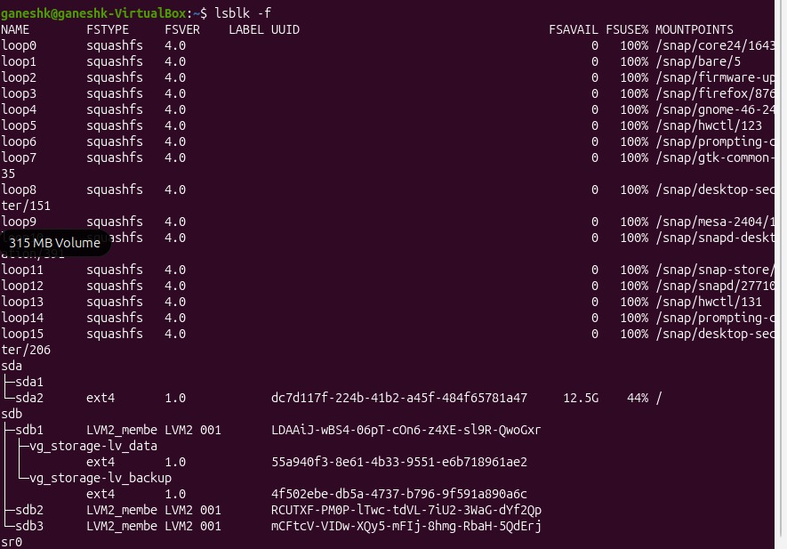
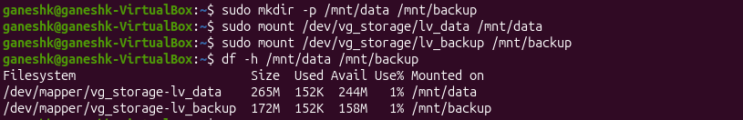
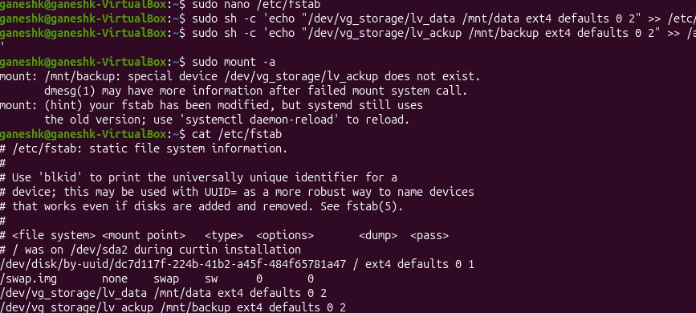
Implementation: Filesystem and Mounting
ext4 filesystem created on lv_data and lv_backup
Mounted at /mnt/data and /mnt/backup
Two entries added to /etc/fstab so the mounts survive a reboot
ADD SCREENSHOT HERE
phase4_filesystems.png
Output of: lsblk -f
lsblk -f: ext4 on lv_data and lv_backup
sudo mkfs.ext4 /dev/vg_storage/lv_data
sudo mkfs.ext4 /dev/vg_storage/lv_backup
sudo mount /dev/vg_storage/lv_data /mnt/data
sudo mount /dev/vg_storage/lv_backup /mnt/backup
df -h: both volumes mounted
ADD SCREENSHOT HERE
phase4_fstab.png
Output of: cat /etc/fstab
cat /etc/fstab: permanent mount entries

Slide 10
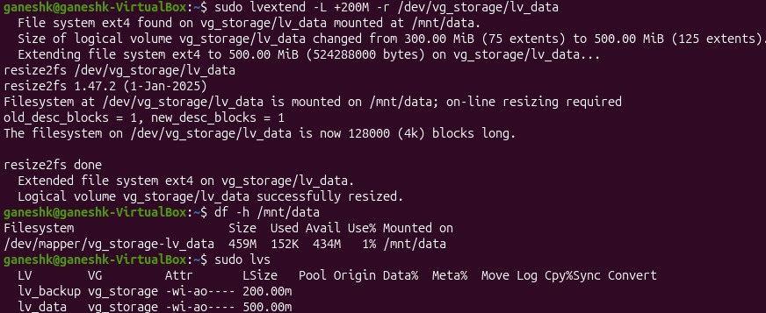
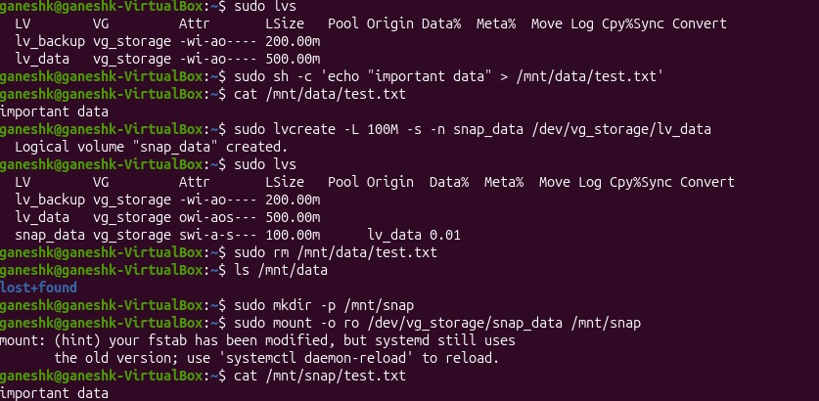
LVM Management: Extend and Snapshot
Extend lv_data online
Snapshot and recovery
lv_data grown from 300 MB to 600 MB
sudo lvextend -L +200M -r /dev/vg_storage/lv_data
The -r option also resizes the ext4 filesystem, with no unmount
Created test.txt, then took a 100 MB snapshot (snap_data)
Deleted test.txt from /mnt/data
Mounted the snapshot read-only and recovered the file
ADD SCREENSHOT HERE
phase4_extend_lv.png
df -h /mnt/data (after) + sudo lvs
ADD SCREENSHOT HERE
phase4_snapshot.png
sudo lvs + cat /mnt/snap/test.txt
df -h /mnt/data after the extend, and lvs
lvs with snap_data, and cat /mnt/snap/test.txt

Slide 11
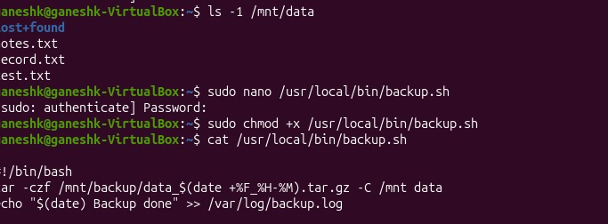
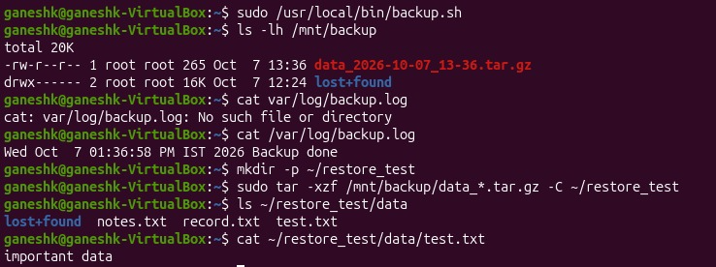
Backup and Restore
1. Backup script
2. Backup run
3. Restore test
backup.sh compresses /mnt/data with tar into /mnt/backup/data_DATE.tar.gz
Running the script creates a timestamped .tar.gz backup in /mnt/backup and updates the log.
Archive extracted into ~/restore_test and the files and contents verified
ADD SCREENSHOT HERE
phase5_backup_script.png
Output of: cat /usr/local/bin/backup.sh
ADD SCREENSHOT HERE
phase5_backup_run.png
ls -lh /mnt/backup + cat /var/log/backup.log
ADD SCREENSHOT HERE
phase5_restore_test.png
ls ~/restore_test/data + cat test.txt
cat /usr/local/bin/backup.sh
ls -lh /mnt/backup and cat /var/log/backup.log
ls and cat in ~/restore_test/data

Slide 12
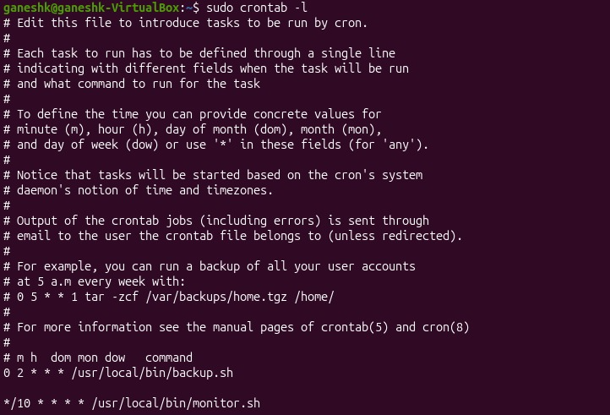
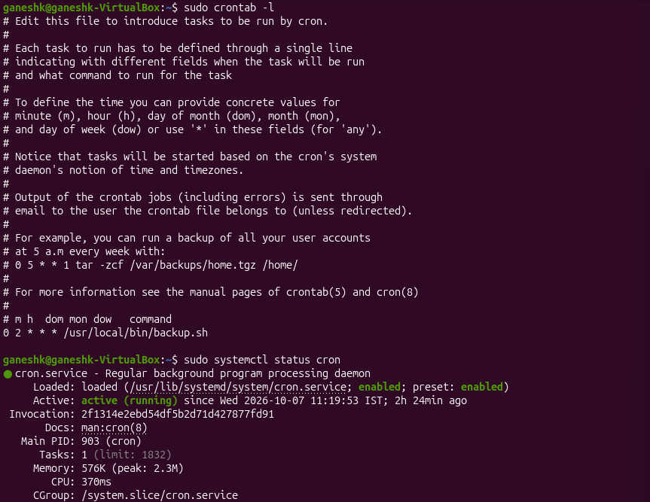
Automation using cron
backup.sh runs every day at 2:00 AM
monitor.sh runs every 10 minutes
The cron service is active (running) and enabled at boot
0 2 * * * /usr/local/bin/backup.sh
*/10 * * * * /usr/local/bin/monitor.sh
crontab -l: backup and monitor jobs
crontab -l and cron service status
Job | Minute | Hour | Day | Month | Weekday
backup.sh | 0 | 2 | * | * | *
monitor.sh | */10 | * | * | * | *

Slide 13
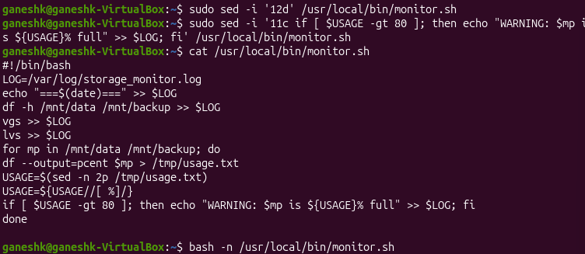
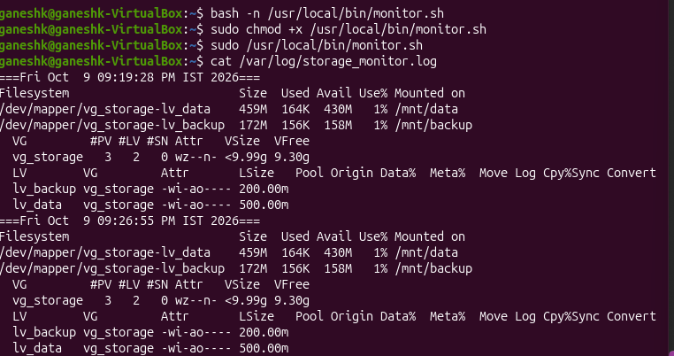
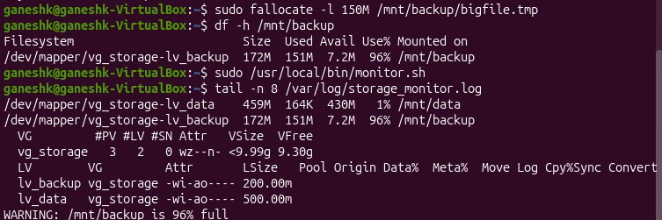
Monitoring
monitor.sh logs df, vgs and lvs to /var/log/storage_monitor.log
It reads the usage of /mnt/data and /mnt/backup
It writes a WARNING when usage is above 80%
Test: /mnt/backup was filled to 96% and the WARNING appeared in the log
monitor.sh (final, syntax checked)
storage_monitor.log after running the script
WARNING written when /mnt/backup reached 96%

Slide 14
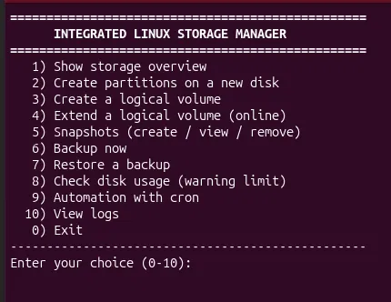
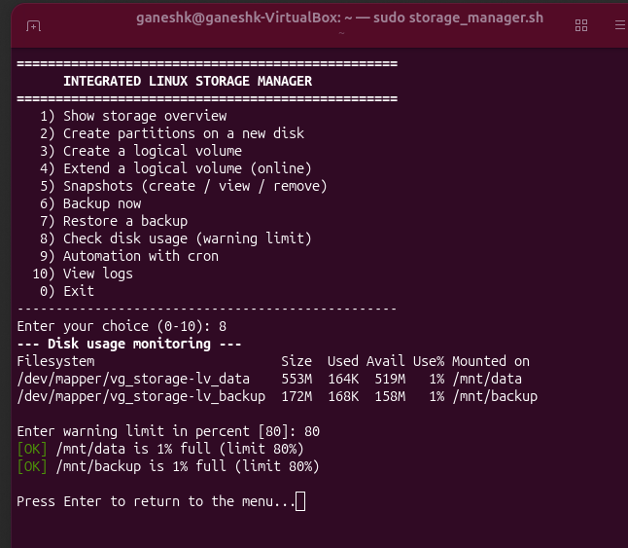
Menu-Driven Interface: storage_manager.sh
Provides 10 menu options for storage overview, partitioning, LVM, snapshots, backup/restore, monitoring, cron and logs.
Working process — User Selection → Input Validation → Linux Command → Result/Error.
Storage_manager.sh(menu)
Storage_manager.sh(menu_test)

Slide 15
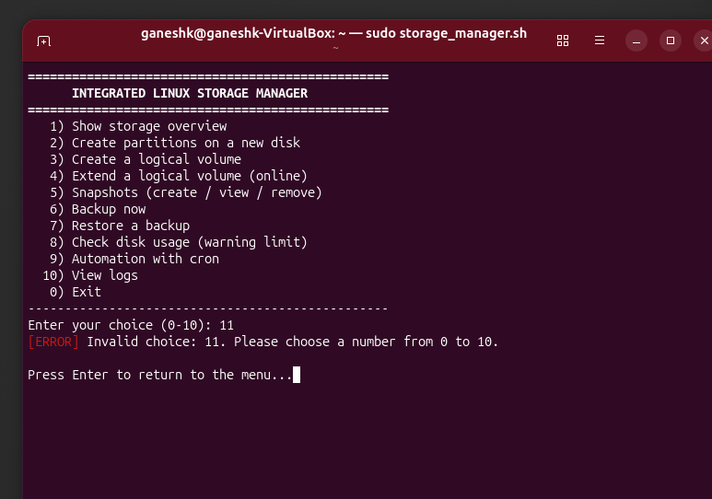
Input Validation & Error Handling
The script validates menu choices, checks inputs, and displays error messages for invalid selections.
Invalid menu choice and error message

Slide 16
Testing Summary
Test | What was done | Result
Extend LV online | lv_data extended online while mounted | Passed
Snapshot | Deleted test.txt and recovered it from snap_data | Passed
Backup | tar.gz archive created in /mnt/backup by backup.sh | Passed
Restore | Archive extracted to ~/restore_test and files verified | Passed
Monitoring warning | /mnt/backup filled to 96% and a WARNING was logged | Passed
Cron automation | monitor.sh ran by itself from cron (new log entry) | Passed
Reboot persistence | Both volumes were mounted again automatically after reboot | Passed

Slide 17
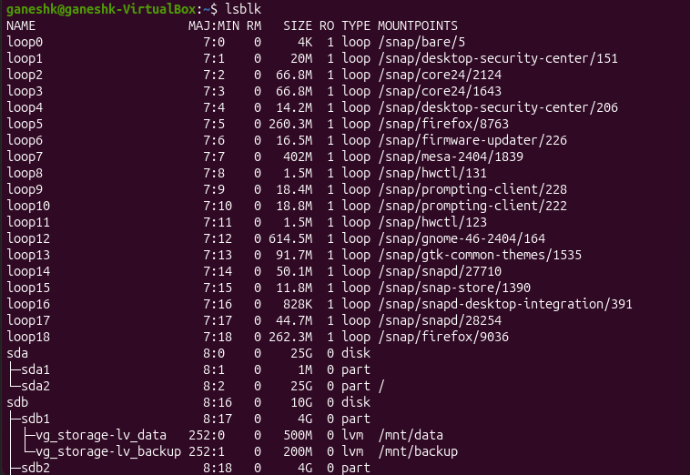
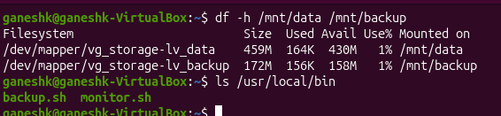
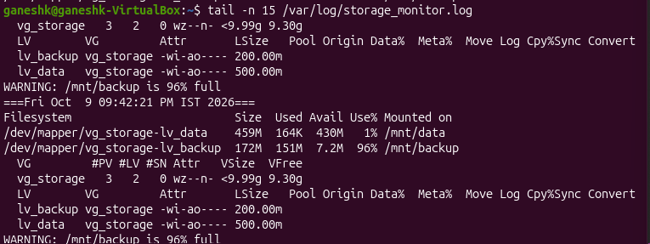
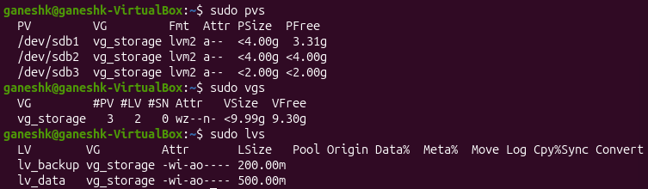
Results and Verification
After reboot: both volumes mounted, scripts present
Log entry created automatically by cron
Storage overview: lsblk
Final overview: pvs, vgs and lvs

Slide 18
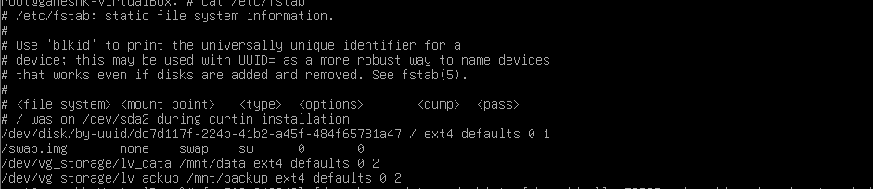
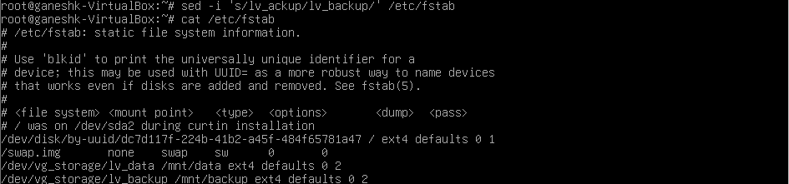
Challenges Faced and Solutions
Problem | Cause | Solution
VM booted into emergency mode | Typo in /etc/fstab: lv_ackup instead of lv_backup | Corrected with sed, tested with mount -a, then rebooted
Pipe and backslash keys not working | Keyboard layout mismatch in the VM | Used pipe-free commands (sed, df --output) and echo with >>
Menu interface and script errors | Script syntax errors and the need for input validation | Checked syntax, corrected errors, and added menu input validation
cat /etc/fstab: the typo lv_ackup in the last line
After the fix: lv_backup

Slide 19
Conclusion and Future Scope
The Linux storage infrastructure was configured and tested on Ubuntu 25.04.
LVM provides flexible storage, while snapshots support data recovery.
Automated backups and cron jobs reduce manual work, and monitoring warns when storage usage exceeds 80%.
The menu-driven Bash interface makes storage operations easier to access.
3
Partitions
10 GB
LVM pool
2 AM
Daily backup
80%
Alert level
FUTURE SCOPE
RAID with mdadm
Add disk redundancy so one failure does not lose data
Email or SMS alerts
Send the WARNING to the administrator
Remote and cloud backups
Copy backups to another server or cloud storage
Encrypted volumes
Protect data at rest using LUKS
Monitoring dashboard
Show usage graphs with tools such as Grafana
LVM thin provisioning
Allocate space on demand for efficient use

Slide 20
References
Canonical Ltd. Ubuntu Server Documentation: Logical Volume Management (LVM). documentation.ubuntu.com/server
Red Hat. Configuring and managing logical volumes. Red Hat Enterprise Linux documentation. docs.redhat.com
Linux man-pages: parted(8), lvm(8), mkfs.ext4(8), fstab(5), crontab(5), tar(1), df(1). man7.org
Oracle. Oracle VM VirtualBox User Manual. virtualbox.org
Free Software Foundation. GNU Bash Reference Manual. gnu.org/software/bash
Thank You | Questions?

